Slide 1

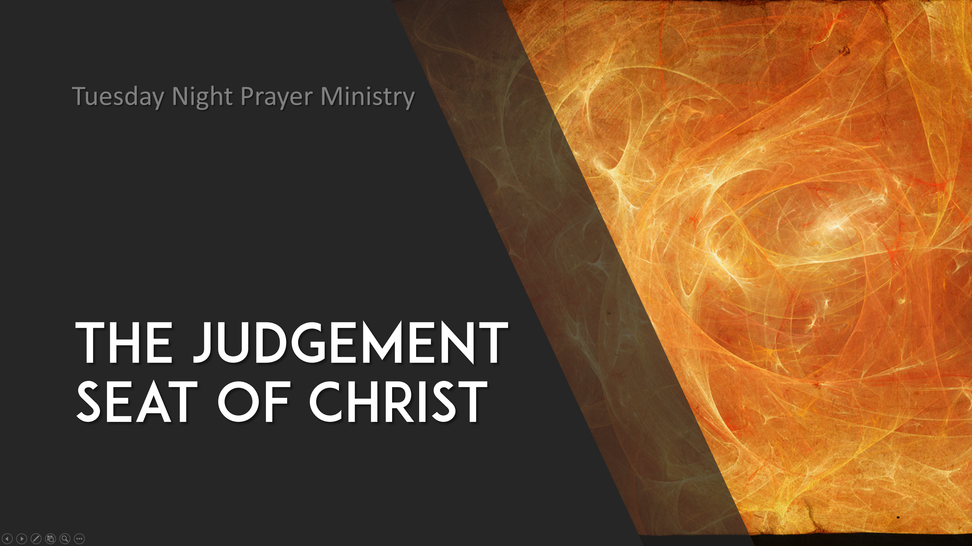

Slide 2

I. A short overview of the JSoC.
Who is at the JSoC? 2 Cor 5:1-19; Rom 14:10
  Jesus
  Us
  Our pastors

Slide 3

Hebrews 13:17 Obey them that have the rule over you, and submit yourselves: for they watch for your souls, as they that must give account, that they may do it with joy, and not with grief: for that is unprofitable for you.
James 3:1 ¶ My brethren, be not many masters, knowing that we shall receive the greater condemnation. (judgment!)

Slide 4
I. A short overview of the JSoC.
Who is at the JSoC? 2 Cor 5:1-19; Rom 14:10
What is the JSoC?
  James 2:6 But ye have despised the poor. Do not rich men oppress you, and draw you before the judgment seats?
  2 Corinthians 5:9-10 Wherefore we labour, that, whether present or absent, we may be accepted of him. 10 For we must all appear before the judgment seat of Christ; that every one may receive the things done in his body, according to that he hath done, whether it be good or bad.

Slide 5
I. A short overview of the JSoC.
Who is at the JSoC? 2 Cor 5:1-19; Rom 14:10
What is the JSoC?
  Jesus is the judge!
  John 5:22 For the Father judgeth no man, but hath committed all judgment unto the Son:

Slide 6
I. A short overview of the JSoC.
Who is at the JSoC? 2 Cor 5:1-19; Rom 14:10
What is the JSoC?
When is the JSoC?
  After the saint’s life on earth.

Slide 7
Hebrews 9:27 And as it is appointed unto men once to die, but after this the judgment:
Luke 14:14 And thou shalt be blessed; for they cannot recompense thee: for thou shalt be recompensed at the resurrection of the just.

Slide 8
1 Thessalonians 4:13-18 But I would not have you to be ignorant, brethren, concerning them which are asleep, that ye sorrow not, even as others which have no hope. 14 For if we believe that Jesus died and rose again, even so them also which sleep in Jesus will God bring with him. 15 For this we say unto you by the word of the Lord, that we which are alive and remain unto the coming of the Lord shall not prevent them which are asleep. 16 For the Lord himself shall descend from heaven with a shout, with the voice of the archangel, and with the trump of God: and the dead in Christ shall rise first: 17 Then we which are alive and remain shall be caught up together with them in the clouds, to meet the Lord in the air: and so shall we ever be with the Lord. 18 Wherefore comfort one another with these words.

Slide 9
I. A short overview of the JSoC.
Who is at the JSoC? 2 Cor 5:1-19; Rom 14:10
What is the JSoC?
When is the JSoC?
  After the saint’s life on earth.
  Before the Lord returns to earth with His Bride to reign, we see that she has already been rewarded! Rev 19.

Slide 10
I. A short overview of the JSoC.
Who is at the JSoC? 2 Cor 5:1-19; Rom 14:10
What is the JSoC?
When is the JSoC?
Where is the JSoC?

Slide 11
1 Thessalonians 4:13-18 But I would not have you to be ignorant, brethren, concerning them which are asleep, that ye sorrow not, even as others which have no hope. 14 For if we believe that Jesus died and rose again, even so them also which sleep in Jesus will God bring with him. 15 For this we say unto you by the word of the Lord, that we which are alive and remain unto the coming of the Lord shall not prevent them which are asleep. 16 For the Lord himself shall descend from heaven with a shout, with the voice of the archangel, and with the trump of God: and the dead in Christ shall rise first: 17 Then we which are alive and remain shall be caught up together with them in the clouds, to meet the Lord in the air: and so shall we ever be with the Lord. 18 Wherefore comfort one another with these words.

Slide 12
2 Corinthians 5:1-10 For we know that if our earthly house of this tabernacle were dissolved, we have a building of God, an house not made with hands, eternal in the heavens. 2 For in this we groan, earnestly desiring to be clothed upon with our house which is from heaven: 3 If so be that being clothed we shall not be found naked. 4 For we that are in this tabernacle do groan, being burdened: not for that we would be unclothed, but clothed upon, that mortality might be swallowed up of life. 5 Now he that hath wrought us for the selfsame thing is God, who also hath given unto us the earnest of the Spirit. 6 Therefore we are always confident, knowing that, whilst we are at home in the body, we are absent from the Lord: 7 (For we walk by faith, not by sight:) 8 We are confident, I say, and willing rather to be absent from the body, and to be present with the Lord. 9 Wherefore we labour, that, whether present or absent, we may be accepted of him. 10 For we must all appear before the judgment seat of Christ; that every one may receive the things done in his body, according to that he hath done, whether it be good or bad.

Slide 13
I. A short overview of the JSoC.
Who is at the JSoC? 2 Cor 5:1-19; Rom 14:10
What is the JSoC?
When is the JSoC?
Where is the JSoC?
How does the JSoC work?

Slide 14
II. A short approach to surety at the JSoc.
How to have confidence before Jesus at His coming!

Slide 15
1 John 2:24-28 Let that therefore abide in you, which ye have heard from the beginning. If that which ye have heard from the beginning shall remain in you, ye also shall continue in the Son, and in the Father. 25 And this is the promise that he hath promised us, even eternal life. 26 These things have I written unto you concerning them that seduce you. 27 But the anointing which ye have received of him abideth in you, and ye need not that any man teach you: but as the same anointing teacheth you of all things, and is truth, and is no lie, and even as it hath taught you, ye shall abide in him. 28 And now, little children, abide in him; that, when he shall appear, we may have confidence, and not be ashamed before him at his coming.

Slide 16
John 15:4 Abide in me, and I in you. As the branch cannot bear fruit of itself, except it abide in the vine; no more can ye, except ye abide in me.
John 15:7-11 If ye abide in me, and my words abide in you, ye shall ask what ye will, and it shall be done unto you. 8 Herein is my Father glorified, that ye bear much fruit; so shall ye be my disciples. 9 As the Father hath loved me, so have I loved you: continue ye in my love. 10 If ye keep my commandments, ye shall abide in my love; even as I have kept my Father's commandments, and abide in his love. 11 These things have I spoken unto you, that my joy might remain in you, and that your joy might be full.

Slide 17
PRINCIPLE: YOU ARE CONFIDENT WITH
THOSE THAT YOU LIVE WITH AND FOR!

Slide 18
John 14:15 If ye love me, keep my commandments.
John 14:23 Jesus answered and said unto him, If a man love me, he will keep my words: and my Father will love him, and we will come unto him, and make our abode with him.
1 John 4:16-18 And we have known and believed the love that God hath to us. God is love; and he that dwelleth in love dwelleth in God, and God in him. 17 Herein is our love made perfect, that we may have boldness in the day of judgment: because as he is, so are we in this world. 18 There is no fear in love; but perfect love casteth out fear: because fear hath torment. He that feareth is not made perfect in love.

